Slide 1
“The state of the RPAS-art in Europe and its future”
De stand van zaken op gebied van RPAS Innovatie in de organisatie en zijn toekomst
Ir. Rob van Nieuwland
DARPAS voorzitter
BERISUAS end event 6 November 2014

Slide 2
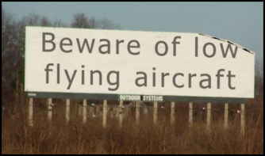
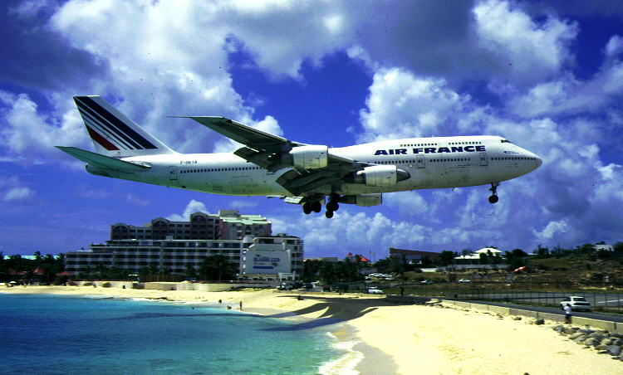
Flightplan
Current situation
Innovation
Future

Slide 3
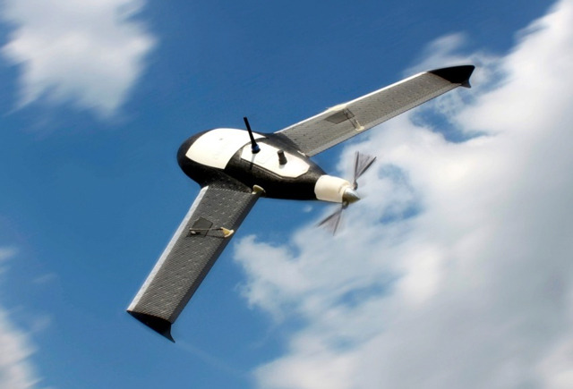
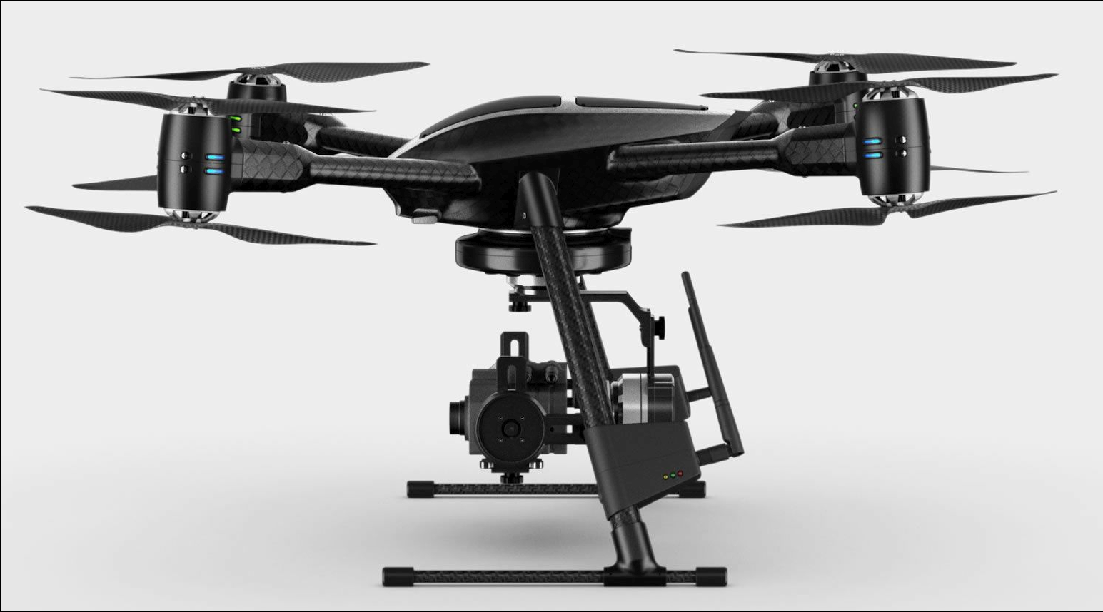
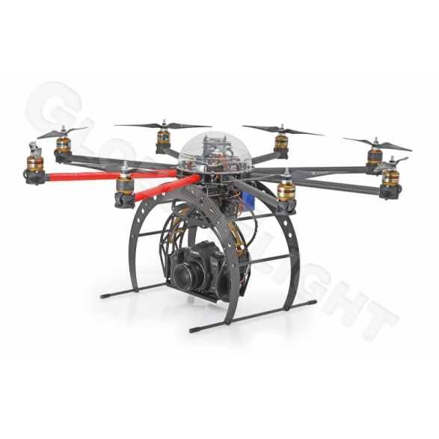
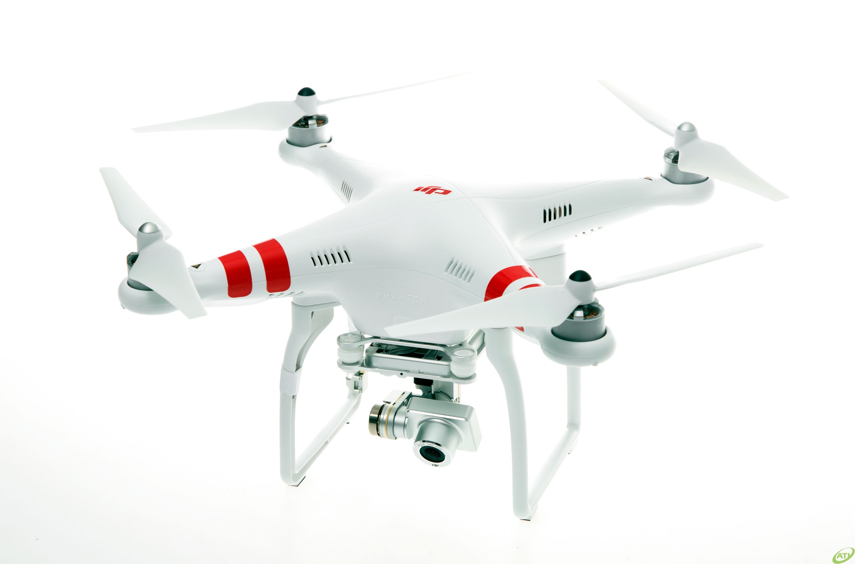
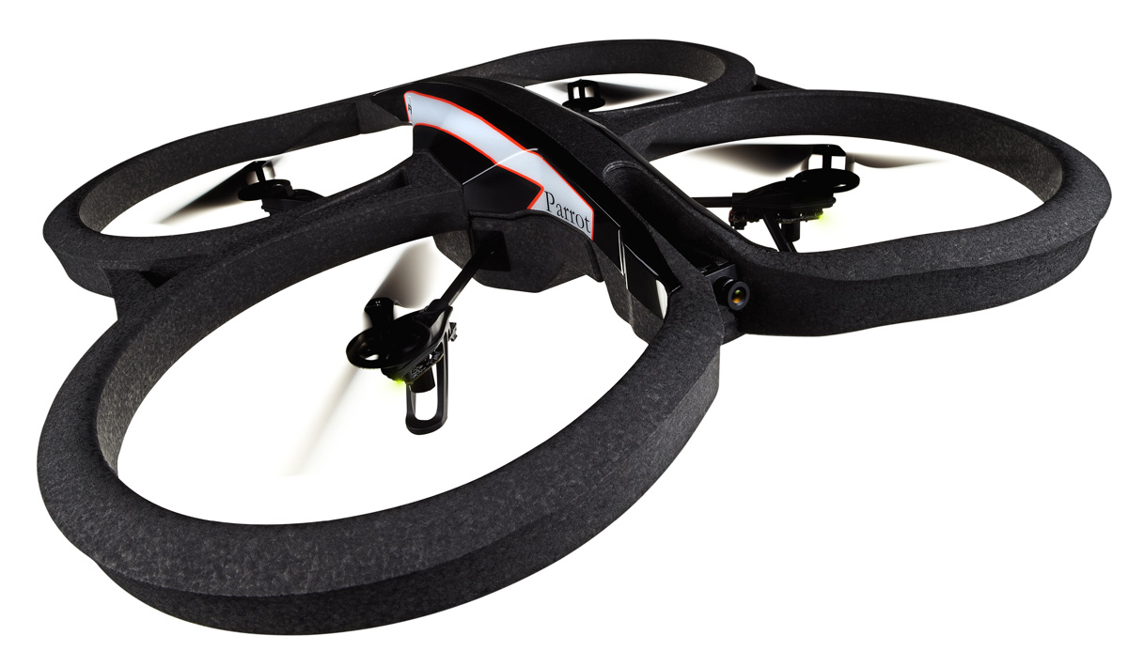
Current Situation
Who are flying RPAS/model aircraft:
The professional
Various “approved” platforms
Good flight preparation
Did take education
Has a CAA license / exemption
Responsible behavior
The “beginning” professional
Various platforms
(still / partially) unknown with air laws
Flies (almost) everywhere
Often no aerospace background
(Unconscious) risc
The serious hobbyist
Toys ++
Applies to the rules of model aircraft flying
On special fields (NL: KNVvL)
Dive into the mater
Responsible behavior
The (occasional) enthusiast
“Toys”
Try-out
On the streets
Unknown of existing rules
Risky

Slide 4
Current situation NL
The Netherlands:
Recent past: Model flying regulation + Military regulation
2013 (1 July): amended model flying regulation with prohibition of professional RPAS use
UNLESS … exemption of NL-CAA (with continuous changes in the requirements )
2015: - (amended) model flying regulation
- RPAS flying regulation (class-1: VLOS) (now in consultation)
(much) later: - RPAS flying regulation (class-2 BVLOS)
Result NL: 12 business exemptions 8 project exemptions

Slide 5
Marktstatus in Nederland
Rond de 175 NL bedrijven actief (productie en services)
Verschillende staten van professionaliteit …
Vliegtuigen <150 kg, veruit de meesten < 10 kg
Razendsnelle ontwikkeling DARPAS:
31 mei 2012: 1e bijeenkomst founding fathers (15 leden ), 22 november 2012 opgericht bij notaris begin novenber 2014: 70 leden (87 inschrijvingen, 17 failliet/gestopt)
68 Bedrijven, 1 Universiteitslab, 1 Veiligheidsregio:
Totaal ca. 175 RPAS bij deze bedrijven. Type toestellen
87 % multicopter
17 % vliegtuigen
11 % helikopters
5 % overig
81 % operators
12 % fabrikanten (productie van ca. 150+/jaar)
7 % scholen/consultants
25 bedrijven bestaan uit 3 of meer werknemers
Totaal ca 250 arbeidsplaatsen (bij DARPAS aangesloten leden)
12 approved operators
8 project operators
Rest: non operating, in opleiding, of …

Slide 6
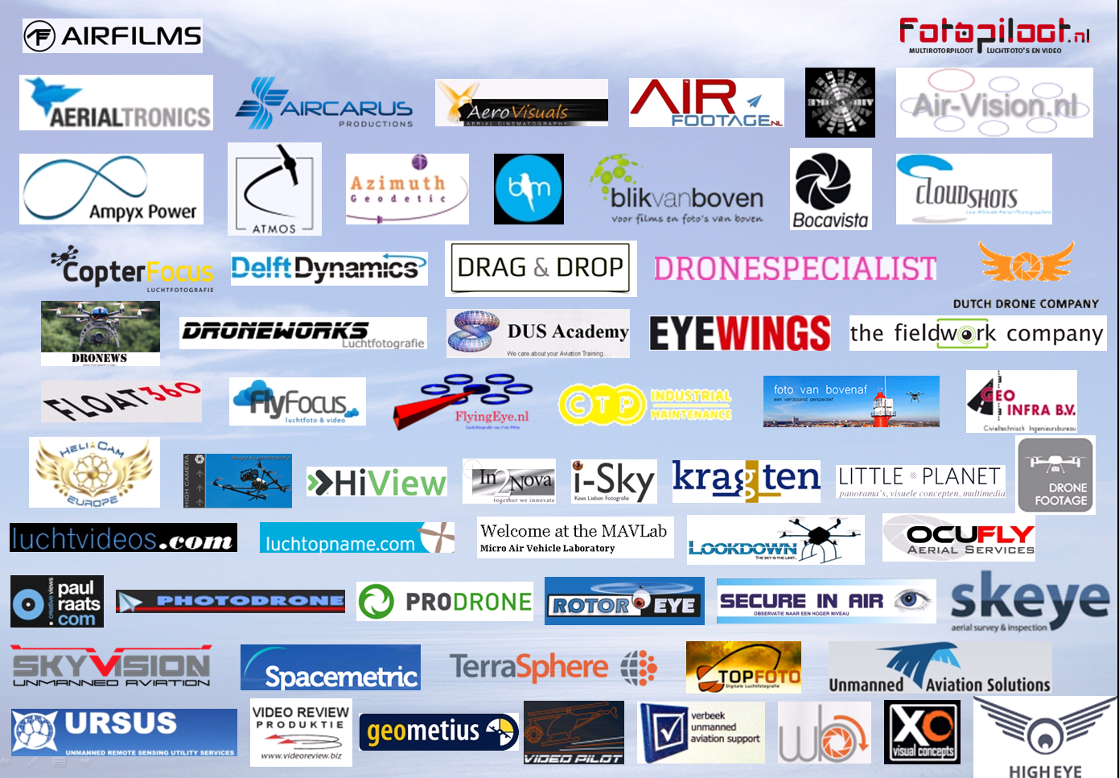
DARPAS leden http://www.darpas.nl/leden/

Slide 7
Current situation UK
UK:
Recent past: Model flying regulation + Military regulation
For VLOS flying
2012: CAP722 weight classes 0 – 20 kg and 20 – 150 kg
With a lighter regime for the lower weight
BVLOS: only with approved method of aerial separation and collision avoidance.
Result UK: 359 approved businesses (1 Nov 2014)

Slide 8
Current situation FR
FR:
Recent past: Model flying regulation + Military regulation
2012: regulation with weight classes for VLOS flying:
0 – 2, 2 – 25 and 25 – 150 kg
With a lighter regime for the lower weight Requirements depend on use profiles
BVLOS: Requirements depend on use profiles
Result: +650 approved businesses (1 Nov 2014)

Slide 9
Current situation BE
Recent past: Model flying regulation + Military regulation
Commercial use: PROHIBITED
2014: Failed attempt to create RPAS regulations for commercial use: only research exemptions
Emergency services fly under State Aircraft regulations
Result: a few businesses with research exemptions state aircraft RPAS flying with o.a. police

Slide 10
Innovation
Technology:
Reliability (no fly aways, no take-overs, no crashes)
Sense, detect and avoid (fixed obstacles, other air trafic)
Improve position determination (GPS, IMU, other …)
Miniaturisation with preservation of stability
Connectivity: drone part of the network
Longer endurance
Law and rule making
Proportional requirements
Less based on manned aviation rules (relation with technology)
Positive attitude to Training and Demo locations
User profiles
Miniaturasation of payloads
Exploration in research projects: 3i, BERISUAS, UAS MV (NL)
UAS Maintenance Valley
BERISUAS

Slide 11
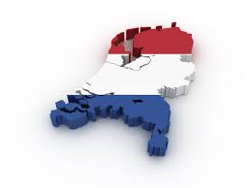
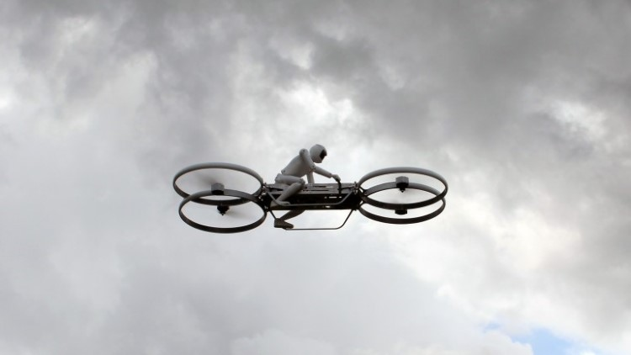
Future
From “hockey-puck” to the whole under layer of airspace
From National towards international rulemaking
ICAO
Not only from A => A, but also from A => B
and longer, higher, further away
Social relevance becomes a big driver in acceptance
Impact on manned aviation

Slide 12
Inspiring examples
Team Black Sheep Amsterdam http://www.youtube.com/watch?v=0q1GNCSaeyc
Eerste vlucht van de Delfly Micro: http://www.youtube.com/watch?v=L17Ox4FQTkM
DIY: Drone It Yourself http://thecreatorsproject.vice.com/blog/a-diy-kit-that-lets-you-build-your-own-drone
3i-2SEAS-20 movie: https://www.youtube.com/watch?v=wHQnpfgvK1o
RPAS van papier http://www.kickstarter.com/projects/393053146/powerup-30-smartphone-controlled-paper-airplane#!
Hover Bike: http://www.youtube.com/watch?v=sVYwDeoPpyM
Eerste vlucht bemande elektrische multicopter E-Volo http://www.youtube.com/watch?v=ou1QTnYrKv8
Bemande ambulance: http://www.liveleak.com/view?i=1f9_1392377014

